Slide 1



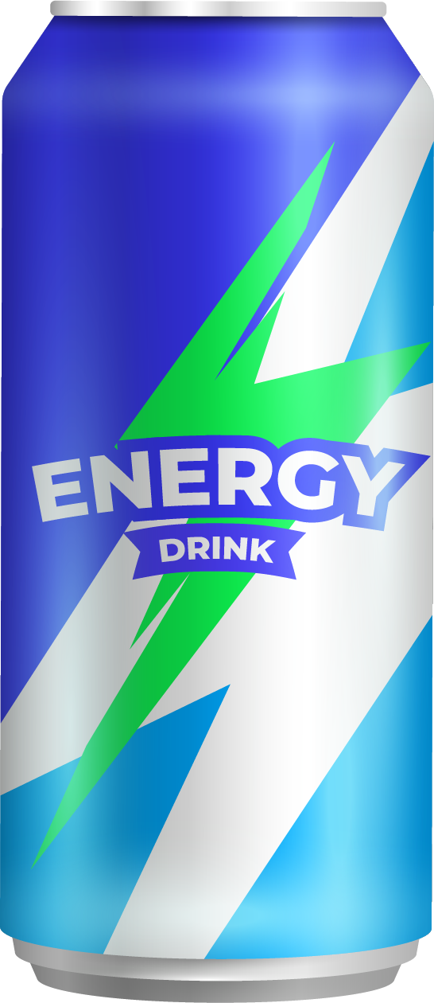


^{SOFT DRINK}
Market Survey Analysis
of
Templete attribute: https://slidesgo.com/theme/energy-drink-pitch-deck#search-Drink&position-3&results-165

Slide 2
TABLE OF CONTENTS
01
Introduction
02
Demographic Insights
03
Consumer Preferences
09
Conclusion and Strategy Forward
04
Competition Analysis
05
Marketing Channels and Brand Awareness
06
Brand Penetration
07
Purchase Behavior
08
Product Development Focus

Slide 3
CodeX
Is a soft drink venture hailing from the heart of Russia country. With a commitment to blending its rich local flavors with sustainable packaging, and to invigorate taste buds globally.

Slide 4

01
INTRODUCTION
Notes:
1. "Did you know that energy drink consumption has surged by 33% in the past decade alone? Join us as we uncover the untapped potential in this booming market and unveil our strategy to redefine the game with innovative flavors and targeted marketing

Slide 5

INTRODUCTION
Global energy drink market is projected to reach a staggering $84 billion by 2026.
Source- GITNUX MARKETDATA REPORT 2024
Notes:
Did you know that the global energy drink market is projected to reach a staggering $84 billion by 2026? Now, imagine tapping into this booming industry with a unique twist. Today, we'll explore how our innovative approach to energy drinks is poised to revolutionize consumer preferences and carve out a lucrative niche in this dynamic market.“

Slide 6

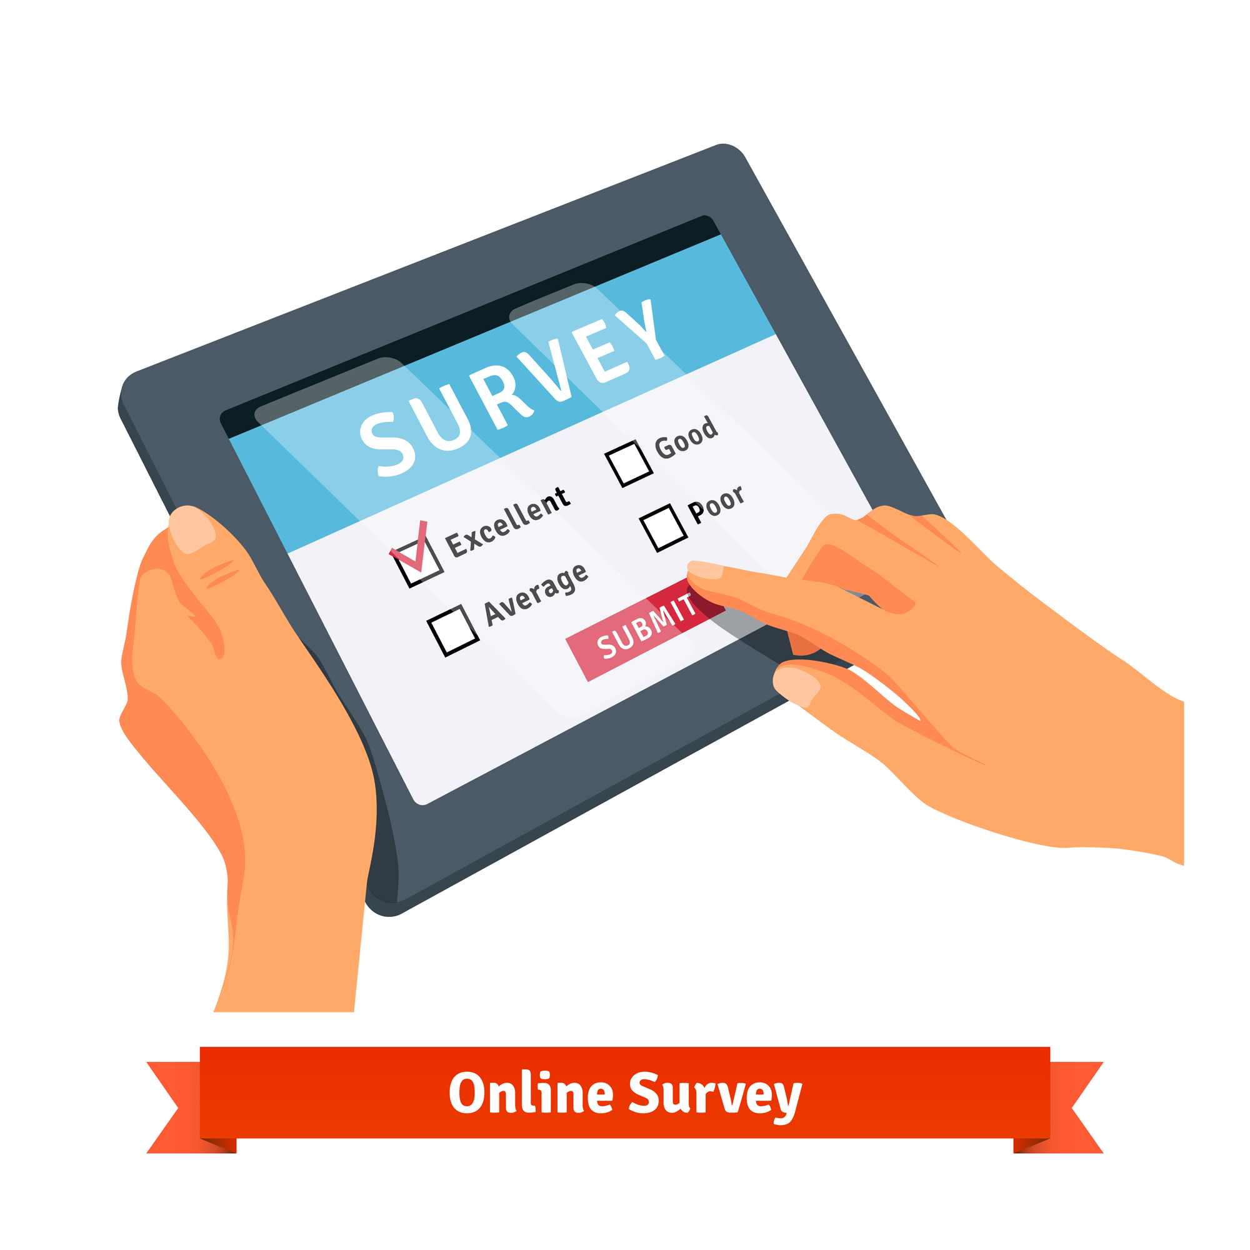
SURVEY
The energy drink recently debuted in 10 cities across India.
After a year the marketing team conducted a survey involving 10,000 participants residing in these cities.
Based on the survey some insights have been presented in this presentation.
Image attribute: <a href="https://www.freepik.com/free-vector/online-survey tablet_1311196.htm#query=survey&position=1&from_view=keyword&track=sph&uuid=d5561861-e1eb-47e0-a9dd-428e728aa5ec">Image by iconicbestiary</a> on Freepik
Notes:
The energy drink recently debuted in 10 cities across India. The Marketing team's objectives include enhancing brand recognition, expanding market share, and refining product offerings. To achieve these goals, they conducted a survey involving 10,000 participants residing in these cities.

Slide 7
02
Demographic Insights

Slide 8
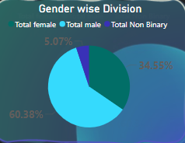
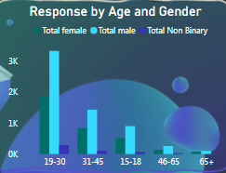
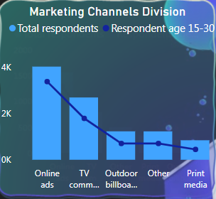
INSIGHTS on Demography
Male dominance in energy drink preference
Youth prefer ; interest wanes with age
Youth favor online marketing channels.
Introduce low-calorie alternatives for females, implement a loyalty program or rewards to increase repeat customers, and incorporate youth-centric flavors, along with gamification techniques, into marketing efforts..
….Continue
Notes:
Introduction: "Understanding the demographic landscape is crucial for effective market targeting and strategy development. Let's delve into key insights from our demographic analysis.“
Visual Representation: "Utilizing graphs and charts, we'll visualize demographic preferences to gain actionable insights.
PIE- According to our survey findings, the preference for energy drinks skews towards males, constituting 60% of the surveyed population. Females represent 30% of the preference, while 10% identify as non-binary. This pie chart vividly illustrates the distribution of energy drink preference across different gender identities.
AGE BAR- "In our survey, we found a clear trend in age preferences for energy drinks. The age group between 19 and 30 emerges as the most dominant, showing significant interest in these beverages. However, as age increases, we observe a decline in interest. Notably, among those aged 65 and above, only a small fraction, specifically 190 out of 10,000 respondents, expressed interest in energy drinks. This insight highlights the importance of targeting younger demographics in our marketing efforts.“
Marketing bar - "Online marketing emerges as the most effective channel in reaching the youth demographic, commanding a 40% preference. TV commercials follow closely behind, while print media ranks lowest in engagement. This trend persists consistently across all age groups, with the 15-30 age bracket showing the highest reliance on digital platforms for marketing outreach.
ANSWERS=
Launch targeted advertising campaigns that emphasize the benefits of our energy drinks for female consumers, such as increased energy and focus.
Collaborate with female influencers or wellness experts to endorse our products and build trust among female consumers.
Introduce product variations or flavors tailored to female tastes and preferences, such as fruit-infused options or low-calorie alternatives.
Host events or workshops focused on health and wellness topics that appeal to female consumers, positioning our brand as a lifestyle choice.
Implement loyalty programs or rewards tailored to female customers to foster brand loyalty and encourage repeat purchases.
Introduce youth-centric flavors and packaging designs to resonate with their preferences and lifestyles.
Partner with popular youth-oriented events or festivals to increase brand visibility and engagement.
Leverage social media platforms to connect with youth influencers and create buzz around our products.
Offer exclusive discounts or promotions targeted specifically at the youth demographic to incentivize purchases.
Implement gamification elements in marketing campaigns to appeal to the competitive nature of young consumers and encourage repeat purchases.

Slide 9
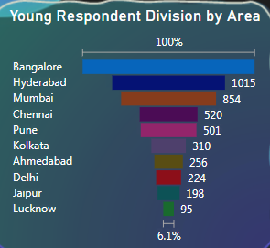
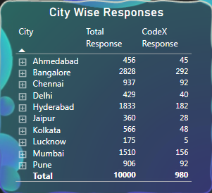
INSIGHTS on Demography
Modern Cities dominants
Benglore leads, Lucknow lags behind
Retailers, Generate Buzz, Hoardings, Promotional Events with Discounts.
Enhance the CodeX brand with a brand ambassador.
Notes:
Funnel - In the 19-30 age group, Bangalore emerges as the top city with the highest response rate for soft drinks, followed by Hyderabad and Mumbai. Surprisingly, Lucknow ranks lowest in terms of young people consuming soft drinks. This trend may be attributed to factors such as urbanization, lifestyle preferences, and availability of trendy hangout spots or cafes catering to the youth culture, which are more prevalent in cities like Bangalore, Hyderabad, and Mumbai compared to Lucknow
Out of the total 10,000 respondents surveyed, a significant 980 individuals are loyal consumers of Codex, indicating a strong market presence. Among cities, Bangalore emerges as the largest consumer hub for both total soft drink consumption and Codex users. Conversely, Jaipur and Lucknow rank at the bottom with the lowest number of Codex users, suggesting potential areas for targeted marketing and brand expansion efforts.“
ANSWERS= Establish partnerships with local retailers and distributors to expand our presence in tier 2 cities and improve product availability.
Tailor marketing campaigns to resonate with the cultural and lifestyle preferences of consumers in tier 2 cities, highlighting the affordability and benefits of our products.
Conduct promotional events or activations in key locations within tier 2 cities to generate buzz and attract new customers.
Offer localized promotions or discounts to incentivize purchases and drive sales in tier 2 cities.
Leverage digital marketing channels, such as social media and online advertising, to reach consumers in tier 2 cities and drive traffic to retail outlets or online stores.
Enhance the CodeX brand by appointing Surya Kumar Yadav as the national brand ambassador, amplifying brand recognition and credibility. Additionally, recruit state-wise ambassadors to foster regional connections and engage with consumers on a personal level, driving brand loyalty and sales. By leveraging the influence of these ambassadors, CodeX can strengthen its market presence and connect with diverse audiences across the nation.

Slide 10
03
Consumer Preferences

Slide 11
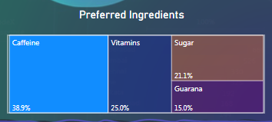
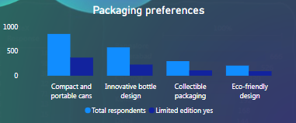
INSIGHTS on Consumer Preference
Caffeine preferred; Guarana least liked
Cans top choice; bottles also gaining popularity
Incorporate catchy names like "EnergiVit" or "VitaBoost" to resonate with consumers.
Opt for sleek packaging, eco-friendly materials (like Mama Earth), reusable bottles, and offer premium customizable options.
Notes:
Tree map - In our survey, caffeine emerges as the preferred ingredient among respondents, with 39% indicating its importance in energy drinks. Following closely behind are vitamins and sugar, showing significant preference among consumers. Interestingly, guarana ranks lowest at 15%, suggesting lesser popularity compared to other ingredients. These insights underscore the importance of catering to consumer preferences when formulating energy drink recipes.
Bar= respondents overwhelmingly preferred compact and portable cans as their preferred packaging option for energy drinks. Following closely behind were innovative bottle designs, indicating a desire for convenience and practicality. Interestingly, a subset of respondents also expressed a preference for premium packaging options, suggesting a market segment willing to invest in higher-quality presentations. These insights highlight the importance of offering diverse packaging options to cater to varying consumer preferences and enhance overall product appeal.
"EnergiVit" seems to be a fictional product name, likely combining the words "energy" and "vitamin." It suggests a product that provides both energy and essential vitamins.
Harness the energy-boosting benefits of caffeine to enhance alertness and improve cognitive function. Additionally, incorporate vitamins such as B-complex vitamins to support energy metabolism and mental clarity. Vitamin C can bolster immunity, while vitamin D aids in bone health and overall well-being. By combining caffeine with essential vitamins, our product offers a holistic approach to energy and wellness.
Introduce sleek and modern packaging designs with vibrant colors to grab consumer attention on shelves.
Implement eco-friendly packaging materials to align with sustainability trends and appeal to environmentally conscious consumers.
Incorporate innovative packaging features such as resealable lids or easy-grip bottles for added convenience and functionality.
Utilize transparent packaging to showcase the product's quality and visually communicate key selling points.
Explore packaging customization options, allowing consumers to personalize their experience and foster brand loyalty.

Slide 12
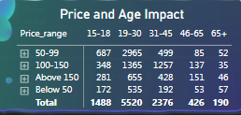
INSIGHTS on Consumer Preference
Sales peak in 50-99 rupees range, targeting 19-30 age group.
Introduce smaller-sized or multipack options to cater to varying budget constraints.
Notes:
Soft drink sales are most prominent in the 50-99 rupees price range, appealing to a broad demographic. Among consumers, the age group of 18-35 demonstrates the highest purchasing activity. This pricing strategy aligns with the preferences of this demographic, ensuring affordability and accessibility. Understanding this trend allows for targeted marketing efforts to capitalize on the preferences of the most active consumer segment. Adjusting promotional strategies to emphasize value and affordability within this price range can further drive sales and brand loyalty.
To increase premium price sales, consider enhancing product presentation and introducing limited edition packaging. Emphasize unique flavor profiles or specialty ingredients to justify the higher price point. Collaborate with renowned chefs or mixologists to create exclusive recipes or signature cocktails using the product. Offer personalized experiences such as VIP tastings or behind-the-scenes tours to create a sense of exclusivity. Implement targeted marketing campaigns that highlight the luxury and sophistication associated with the premium product range.

Slide 13
04
Competition Analysis

Slide 14
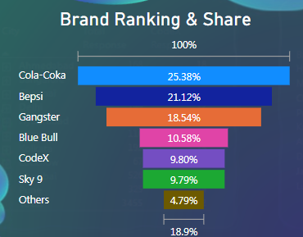
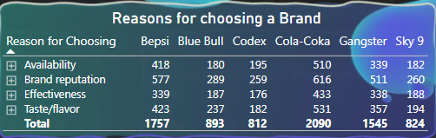
INSIGHTS on Competition Analysis
Cola-coka dominates market share
Need to Improve availability, taste, brand reputation
Expand distribution, transparent communication, consistent quality, trust-building initiatives. Like Implementing a customer feedback system and promptly addressing any issues raised.
Conduct taste tests, experiment with natural flavor extracts like strawberry, as well as herbal extracts such as mint and basil.
Notes:
Funnel- With Coca-Cola holding a 25% market share and Pepsi and Gangster Codeis following closely behind at 9.8%, we recognize the need to ascend in the rankings. Our strategy entails innovative marketing initiatives and product enhancements to capture a larger share of the market. By focusing on consumer engagement and brand differentiation, we aim to carve out a more prominent position within the competitive landscape
Why they preferred others then ours- ------Consumers favor competitors due to their strong brand reputation, widespread availability, perceived effectiveness, and preferred taste. To elevate Codex's position, we must bolster our brand image through targeted marketing efforts, expand distribution channels to enhance accessibility, ensure consistent product availability, and prioritize product development to enhance taste and effectiveness. By focusing on these key areas, Codex can strengthen its competitive edge and appeal to a broader consumer base.“
To improve availability and brand reputation, consider expanding distribution channels to reach more retailers and online platforms. Enhance brand perception through transparent communication, customer testimonials, and positive reviews. Additionally, prioritize consistency in product quality and customer service to build trust and loyalty among consumers.
One idea for taste improvement could be to conduct taste tests with focus groups to gather feedback on current flavors and identify areas for enhancement. Additionally, experimenting with natural flavor extracts and incorporating trending flavor profiles could help create exciting new options that appeal to a wider audience.

Slide 15
05
Marketing Channels and Brand Awareness

Slide 16
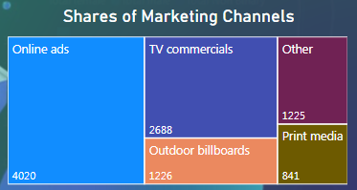
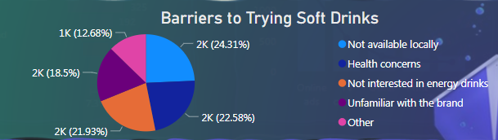
INSIGHTS on Marketing Channels
Online marketing most effective for customer reach.
Top barriers: local availability, health concerns, brand awareness.
Invest in targeted social media ads and influencer partnerships to maximize online reach and engagement.
compelling educational content demonstrating product benefits aligned with consumer lifestyles.
Notes:
Tree- Our analysis indicates that online advertising is the most effective marketing channel for reaching customers, with a total of 4,020 respondents citing it as their preferred medium. TV commercials follow with 2,688 mentions, highlighting their continued relevance in consumer engagement. Outdoor billboards also play a significant role, although to a lesser extent, demonstrating the value of visual impact in public spaces. Print media, while less influential than digital and broadcast options, still contributes to a diversified marketing strategy. Given these insights, Codex should prioritize digital marketing efforts while maintaining a presence across traditional platforms to maximize reach and brand visibility.
Barrier- The primary barrier to trying Codex drinks, as indicated by 24% of respondents, is the lack of local availability, suggesting a need to expand our distribution network. Health concerns follow closely at 22%, highlighting an opportunity for Codex to emphasize the health benefits and nutritional aspects of our products. A significant number of people also mentioned a general disinterest in energy drinks and a lack of brand awareness. Addressing these challenges requires targeted marketing campaigns to boost brand recognition, along with efforts to make Codex more accessible. By focusing on these areas, we can overcome the barriers and encourage more consumers to try Codex.
Invest in social media advertising on platforms like Facebook, Instagram, and Twitter, targeting specific demographics based on interests and behaviors.
Utilize search engine marketing (SEM) to increase visibility on Google and other search engines, ensuring our brand appears prominently in relevant search results.
Collaborate with popular influencers or content creators in our industry to leverage their reach and credibility in promoting our brand and products.
Develop engaging video content for platforms like YouTutilizing storytelling and creativity to capture audience interest and drive brand awareness.
Address health concerns by transparently communicating product ingredients and benefits; for disinterested individuals, offer engaging educational content showcasing product value and relevance to their lifestyle.

Slide 17
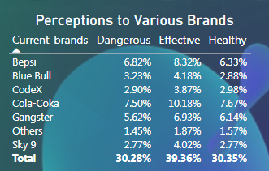
INSIGHTS on Brand Awareness
Perceptions vary: 40% effective, 30% dangerous, 30% healthy.
Leverage healthcare endorsements and educational events to promote product safety and dispel myths about energy drinks.
Notes:
MAtrix- Brand awareness plays a crucial role in consumer perception, with respondents divided on their views of Codex drinks. While 40% perceive Codex as effective, indicating positive brand recognition, 30% associate it with health concerns, suggesting the need for clear communication about the product's benefits. However, an equal 30% express concerns about Codex being dangerous, highlighting the importance of addressing safety perceptions. This nuanced perspective underscores the complexity of managing brand reputation in a competitive market. Codex must prioritize transparency and education to dispel misconceptions and build trust among consumers. Through targeted messaging and product innovation focused on safety and efficacy, we can shift perceptions and establish Codex as a trusted choice for consumers seeking both effectiveness and health-conscious options.
2. 45% of respondents are familiar with Codex, indicating moderate brand awareness. Among them, 27% have expressed a positive response, reflecting a favorable perception of the brand. This suggests a foundation for growth, with potential to further strengthen brand loyalty through targeted marketing and product enhancements. By capitalizing on this existing awareness and positive sentiment, Codex can strategically position itself for increased market penetration and consumer engagement.
Collaborate with healthcare professionals to endorse the product's safety and efficacy through educational campaigns. Conduct consumer education seminars or workshops to dispel myths and misinformation surrounding energy drinks.

Slide 18
06
Brand Penetration

Slide 19
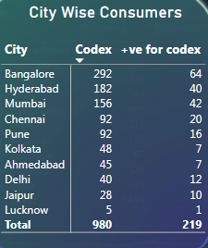
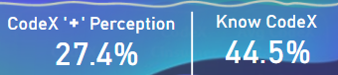
INSIGHTS on Brand Penetration’
Out of the total surveyed respondents, 45% are familiar with Codex, with 27% showing a positive response.
Perceptions vary: 40% effective, 30% dangerous, 30% healthy.
Forge partnerships with local influencers and establishments to elevate Codex's presence and garner community endorsements.
Notes:
45% of respondents are familiar with Codex, indicating moderate brand awareness. Among them, 27% have expressed a positive response, reflecting a favorable perception of the brand. This suggests a foundation for growth, with potential to further strengthen brand loyalty through targeted marketing and product enhancements. By capitalizing on this existing awareness and positive sentiment, Codex can strategically position itself for increased market penetration and consumer engagement
2. In Bangalore, out of 292 Codex users surveyed, only 64 respondents had a positive response towards the brand, representing approximately 22% positivity. Similarly, in Mumbai, 42 out of 156 users, or around 27%, showed positivity. However, in Lucknow, the percentage of positive responses drops significantly, with only 20% of users expressing favorable sentiments towards Codex. These insights underscore the need for targeted efforts to enhance brand perception and satisfaction, particularly in regions with lower positivity rates.
Answers- To address the lower positivity rates in certain regions, Codex could consider implementing targeted marketing campaigns aimed at improving brand perception and engagement. This could involve conducting localized advertising campaigns highlighting Codex's unique features, benefits, and customer testimonials. Additionally, offering promotional incentives or discounts in these regions could incentivize trial and encourage more positive experiences with the brand. Investing in community engagement initiatives, such as sponsorships or partnerships with local events or organizations, could also help improve brand visibility and foster positive associations with Codex.“
Establish partnerships with popular local establishments or influencers in each city to increase Codex's visibility and endorsement within the community.

Slide 20
07
Purchase Behavior

Slide 21
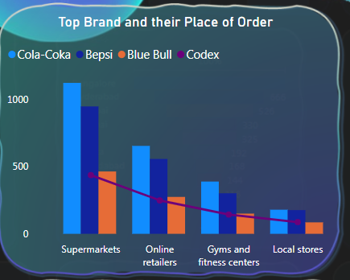
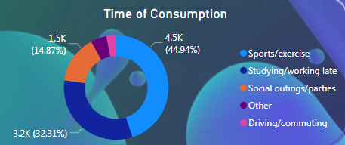
INSIGHTS on Brand Penetration’
"Supermarkets and gyms top choices consistently
Most of respondents consume energy drinks for sports activities
Employing creative marketing initiatives, akin to Cola-Coka's "Share a Cola" campaign, to invigorate brand appeal and stimulate consumer interest.
Notes:
. Respondents prefer purchasing energy drinks from online retailers, supermarkets, and gyms. Given the consistent pattern across different types of drinks, focusing on supermarket and gym channels presents an opportunity to capitalize on consumer preferences and enhance market presence.“
Among respondents, typical consumption situations for energy drinks include sports and physical activities, as well as working late hours. Additionally, some consumers prefer consuming energy drinks during outings or social gatherings. However, the majority, accounting for 45%, use energy drinks specifically for sports-related activities. Understanding these consumption patterns can inform targeted marketing strategies tailored to each scenario, maximizing product relevance and appeal to consumers in various contexts.
Adopting competitive pricing strategies and launching innovative marketing campaigns to capture consumer attention, like Pepsi's "Pepsi Challenge" campaign which led to a surge in market share and brand loyalty.

Slide 22
08
Product Development Focus

Slide 23
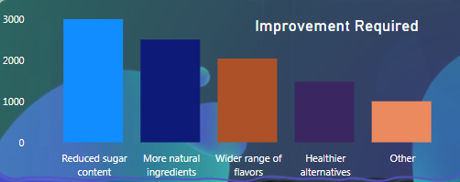
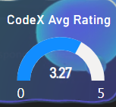
Product Development
Top suggestions include reducing sugar, adding natural ingredients, and expanding flavor options
Codex experience rates 3.27 out of 5
Organic inclusion, low sugar soda range like diet CodeX etc.
Notes:
The most common suggestion to reduce sugar content, followed by requests for more natural ingredients and a wider range of flavors, reflects consumers' growing preference for healthier and diverse beverage options. By addressing these concerns, we can enhance consumer satisfaction and cater to evolving tastes and dietary preferences. Prioritizing product innovation with natural ingredients and expanding flavor varieties can position our brand as a leader in providing healthier and more satisfying beverage choices. This consumer feedback underscores the importance of continuous improvement and adaptation to meet market demands and consumer expectations.“
To improve the average Codex experience rating of 3.27 out of 5, focus on enhancing taste, branding, and availability through flavor innovation, strategic branding initiatives, and expanding distribution channels.
Enhance product quality alongside sugar reduction and organic ingredient inclusion to ensure consumer satisfaction and maintain brand integrity.
Introducing a low-sugar, organic soda range with premium ingredients led to a 15% increase in customer satisfaction and brand loyalty for XYZ Beverage Company.

Slide 24
09
Conclusion and Strategy Forward

Slide 25
Conclusion
The insights gleaned from our analysis of the Indian energy drink market reveal promising opportunities amidst distinct challenges.
While our brand resonates well with male consumers and the youth demographic, there exist notable gaps in brand perception, product availability, and market penetration.
Although our brand has received a fair rating overall, it's crucial to fix these issues and make our brand stronger compared to others.
Based on the survey findings, our attention should be directed towards enhancing taste, refining branding efforts, improving availability, optimizing marketing strategies, fostering innovation, and adjusting pricing strategies.
Notes:
The insights gleaned from our analysis of the Indian energy drink market reveal promising opportunities amidst distinct challenges. While our brand resonates well with male consumers and the youth demographic, there exist notable gaps in brand perception, product availability, and market penetration. Despite achieving a moderate overall brand rating, there is a clear imperative to address these shortcomings and fortify our position in the competitive landscape.

Slide 26
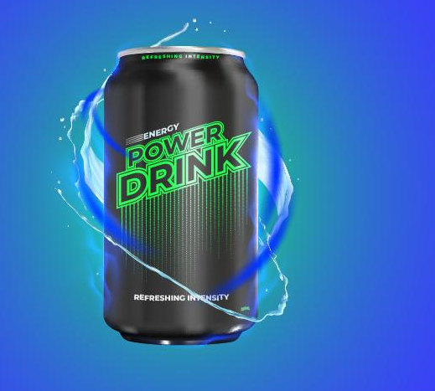
CodeX
Suggested Strategy Forward
Our Brand Must have a Tag Line – one I have Suggested
Fuel Your Adventure with Energy

Slide 27
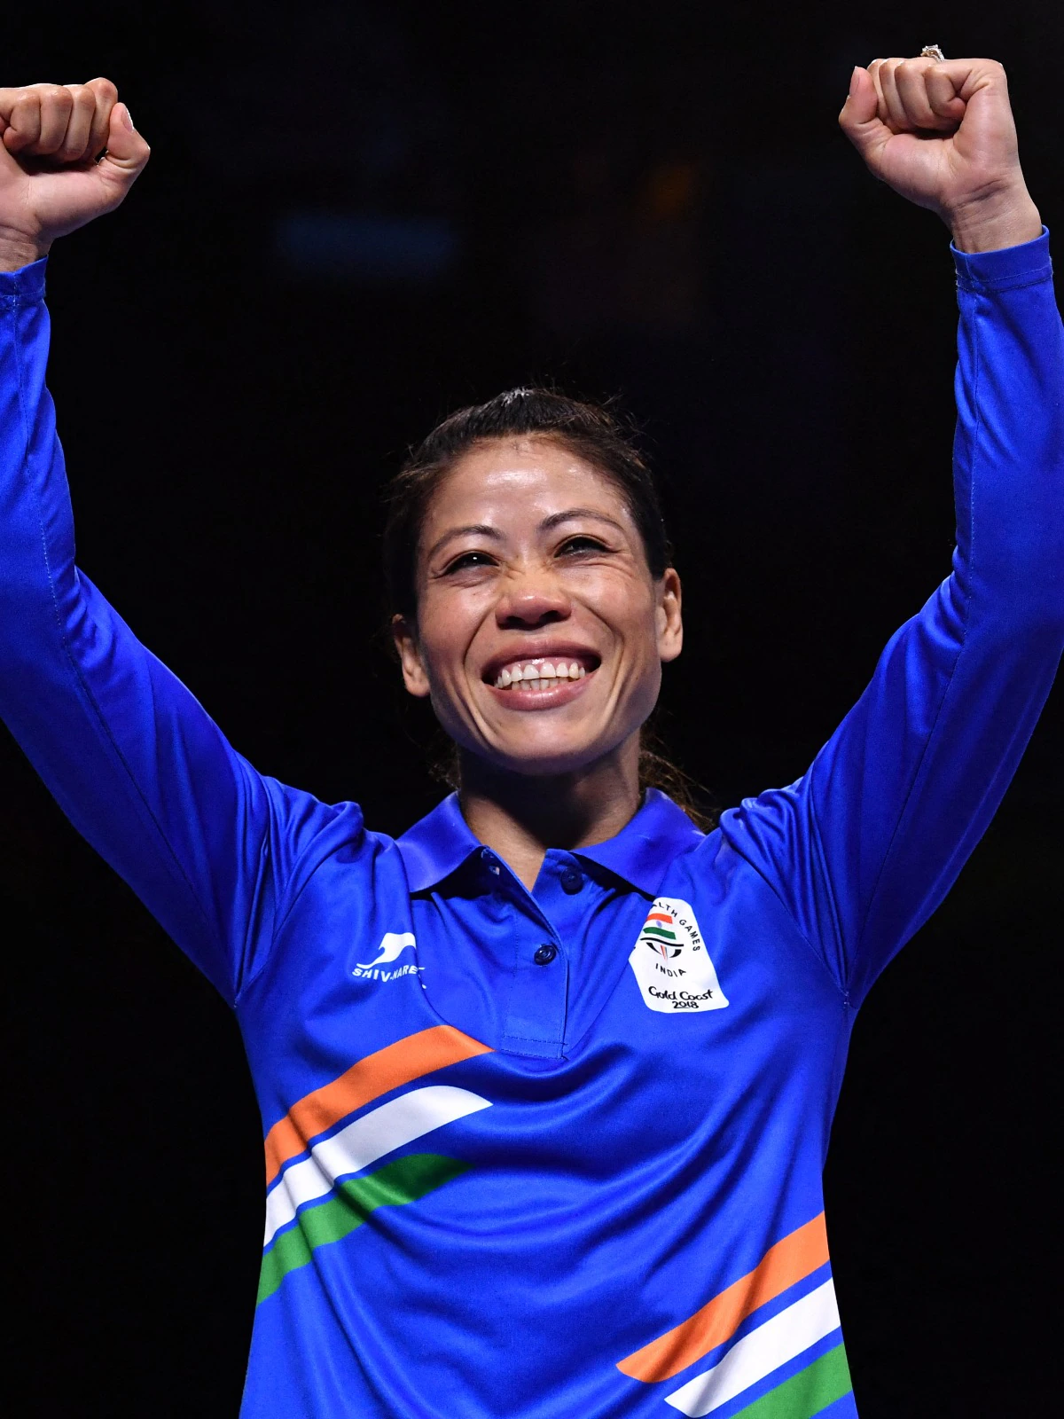
Mary KOM
Suggested Strategy Forward
Appointing Mary Kom as the ambassador for our soda brand.
Mary Kom embodies excellence and resilience
It can benefit from Mary Kom's influence to boost female sales
Notes:
Hiring Mary Kom as our brand ambassador would align our brand with her values of determination, excellence, and resilience, enhancing our brand's credibility and appeal, especially among sports enthusiasts and those who admire her achievements.

Slide 28

IPL
Suggested Strategy Forward
Market Delhi Capitals' IPL jersey sponsorships to drive sales
National recognition through Delhi Capitals sponsorship.
Delhi Capitals' IPL sponsorship impacts sales in Delhi.
Notes:
Hiring Mary Kom as our brand ambassador would align our brand with her values of determination, excellence, and resilience, enhancing our brand's credibility and appeal, especially among sports enthusiasts and those who admire her achievements.

Slide 29
THANK YOU
Codebasics

